Slide 1
What are you afraid of?
Examining belief in government agencies to protect against terrorism and trust in the honesty of the information they provide
Lat’Anna Davis and Stephanie Kern-Allely

Slide 2
Background
Lati

Slide 3
Methods

Slide 4


Methods – Dataset
National Survey of Disaster Experiences and Preparedness (NSDEP, N = 2,029)
National household telephone survey prepared by the National Consortium for the Study of Terrorism and Responses to Terrorism (START)
Interview administered in English or Spanish with gift incentives offered
Data collected in 2007-2008
Adult participants aged 18 and older

Slide 5
Methods – Data Analysis
Logistic regression: Estimate the odds of believing the government could protect from future terrorism based on trust in the government to be honest about terrorism. The association was also assessed across local, state, and federal levels of government.
Model 1 - Unadjusted model of bivariate association between believing the government could protect from future terrorism based on trust in the government to be honest about terrorism
Model 2 – Covariate adjusted model (Age, Education, Belief of information received, Perceived risk of terrorism)

Slide 6
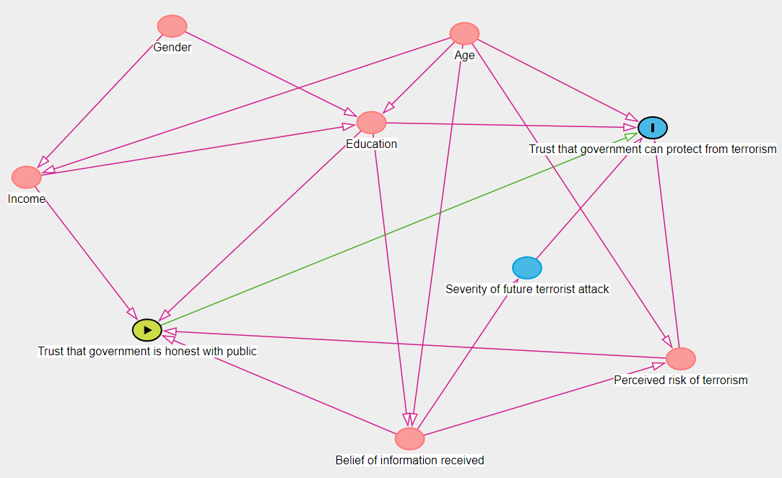
Proposed adjusted model:
Trust that government can protect from terrorism = Trust that government is honest with public + Age + Education + Belief of information received + Perceived risk of terrorism

Slide 7
Methods – Data Analysis
Local
Trust that government is honest with public about terrorism
State
Trust that government can protect from terrorism
Federal
Age + Education + Belief of information received + Perceived risk of terrorism

Slide 8
Methods – Variables
Trust that government can protect from terrorism – Perceived effectiveness
“How sure are you that < ... > could effectively protect you from a future terrorist attack? Would you say ‘1, not at all sure,’ ‘5, extremely sure,’ or you may use any number in between?”
Levels of government: Local government, State government, Federal government
Trust that government is honest with public – Perceived honesty of information about terrorism received by social distance, indicated by level of government
“In your opinion, how honest with the public would you say the < ... > is about terrorism? Would you say ‘1, never honest,’ ‘5, always honest,’ or you may use any number in between?”
Levels of government:
State: Governor, State Office of Emergency Services, State Health Department
Local: Mayor, Local Fire Department, Local Police Department, County/City Health Department
Federal: President of the United States, Department of Homeland Security, Centers for Disease Control, Federal Emergency Management Agency
Notes:
Perceived honesty of information sources is negatively associated with the social distance of the recipient from the source, where social distance is determined by whether agencies and officials are local, state or federal.

Slide 9
Methods – Variables
Belief of information received
“How much of the information that you heard about protecting yourself from terrorism since September 11th, 2001, did you believe? Would you say ‘1, did not believe any of it,’ ‘5, believed all of it,’ or you may use any number in between?”
Perceived risk of terrorism
“How likely is it that a terrorism event like an explosion, biological, chemical, or radiological agents being released in your community will occur in your lifetime? Would you say ‘1, not at all likely,’ ‘5, definitely will occur,’ or any number in between?”

Slide 10
Results

Slide 11
Results
Results. After adjusting for covariates, the odds of believing any level of government could protect against future terrorism were 23.2 times higher among those who trust the government to be honest about terrorism than those who do not. The association was strongest at the local government level (OR=5.78, 95% CI [3.89-8.59]) compared to state (OR=5.58, 95% CI [4.07-7.63]) and federal (OR=4.56, 95% CI [3.62-5.73]).

Slide 12
Results - Demographics
 | Does not trust in government protection from terrorism (n=1741) n (%) | Does trust in government protection from terrorism (n=288) N (%)
Education
HIGH SCHOOL DIPLOMA/GED (OR EQUIVALENT) | 546 (31.4%) | 103 (35.8%)
JUNIOR COLLEGE DEGREE (A.A.) | 160 (9.2%) | 30 (10.4%)
BACHELORS DEGREE (B.A.,B.S.) | 403 (23.1%) | 53 (18.4%)
MASTERS DEGREE (M.A., M.S.) | 247 (14.2%) | 24 (8.3%)
DOCTORATE (PH.D.) | 45 (2.6%) | 1 (0.3%)
PROFESSIONAL (M.D., J.D., ETC.) | 38 (2.2%) | 2 (0.7%)
NONE | 156 (9.0%) | 46 (16.0%)
OTHER | 146 (8.4%) | 29 (10.1%)
Age Median [Min, Max] | 50.0 [18.0, 98.0] | 46.0 [18.0, 88.0]
Belief of information received
1 - Did not believe any of it | 102 (5.9%) | 6 (2.1%)
2 | 294 (16.9%) | 16 (5.6%)
3 | 738 (42.4%) | 74 (25.7%)
4 | 395 (22.7%) | 102 (35.4%)
5 - Believed all of it | 212 (12.2%) | 90 (31.2%)
Perceived risk of terrorism
1 - Not at all likely | 521 (29.9%) | 97 (33.7%)
2 | 416 (23.9%) | 52 (18.1%)
3 | 370 (21.3%) | 71 (24.7%)
4 | 182 (10.5%) | 30 (10.4%)
5 - Definitely will occur | 252 (14.5%) | 38 (13.2%)
Table 1. Characteristics of participants who do or do not trust that government can protect from terrorism

Slide 13
Discussion
Lati

